Slide 1
The Virginia Health Chart Book
Steve Sedlock
Executive Director, VANGHR
Presentation:
Public Health Network of Virginia Tech
November 12, 2012

Slide 2
Please Mute Your Phone to Minimize Background Noise

Slide 3
Virginia Health Chart Book
Interactive, spatially-dynamic web-based application which assists stakeholders in identifying the healthcare, economic and social conditions underlying local workforce development efforts.
The Chart Book provides the ability to view, query, and analyze these data sets within a maps, tables, and charts.

Slide 4
Virginia Health Chart Book
It is a resource for multiple purposes, including health planning and analysis.
The Chart Book is helpful in providing support materials for grant applications, including workforce-related grants.

Slide 5
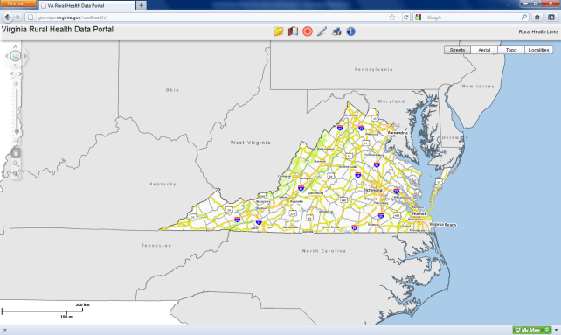
Scope continued
The Health Chart Book and all of its related functionality are built upon the existing infrastructure of the Virginia Rural Health Data Portal (http://vrhrc.org/data-portal/).
Virginia Health Chart Book

Slide 6
Features of Health Chart Book
User-defined spatial aggregation capabilities:
Standard Boundaries: Market regions, local health districts, planning district commissions, regional commissions, development regions, others.
Dynamic User-Defined Boundaries: User defined ranging from census tracts to counties/cities.
Point Data Summaries: Hospitals, rural health clinics, health providers, others.
Non-Coterminous Boundaries: For side-by-side comparison.

Slide 7
Features continued
Data:
Social and Demographic Data: All data from the Virginia Rural Health Data.
Population Dynamics: Demographic shifts over time, e.g., population churning, age-specific shifts, immigrant populations, persistence of poverty.
Population Projections: City/county level.
National Ambulatory Medical Care Survey (NAMCS): Age-specific utilization rates for primary care specialties.
Health Provider and Facility Data: Categorized by specialty.

Slide 8
Features continued
Data:
Hospital Discharge Data:
Adult and Pediatric Prevention Quality Indicators (PQI) for the most recent five-year period.
Drive time analysis from the ZIP Code of residence to the hospital will be calculated for both the composite PQI and the individual indicators.
Additional specific conditions.

Slide 9
The Prevention Quality Indicators (PQIs) are a set of measures that can be used with hospital inpatient discharge data to identify quality of care for "ambulatory care sensitive conditions."
These are conditions for which good outpatient care can potentially prevent the need for hospitalization or for which early intervention can prevent complications or more severe disease.
www.qualityindicators.ahrq.gov/modules/pqi_resources.aspx

Slide 10
High Priority Target Areas
“High priority target analysis (HPTA) allows users to examine the interaction of two health or social determinants in a specific geographic area. In the analysis, two indicators are combined, ordered, and ranked to yield the target area(s). The lowest ranking geographic feature(s) is the high priority target area. This type of analysis enables communities to target geographic areas for intervention and policy change.”

Slide 11
Training and Technical Assistance
Focus group seminars.
Training module.
On-going training and technical assistance.
Routine maintenance.

Slide 12
Demonstration
Stop the boring Power Point and show me something!

Slide 13
www.vahealthchartbook.org

Slide 14
Virginia Network for Geospatial Health Research, Inc.
Incorporated in April 2009
501(c)[3] non profit
Based in Richmond
Focus: The application of geospatial analysis and technology to improve decision making in public health policy.

Slide 15
Support and coordinate existing expertise in geospatial analysis, health policy, health planning, environmental health analysis, and epidemiology.
Facilitate the development of new approaches and methodologies to sustain effective public health and health care interventions throughout Virginia and the nation.
VANGHR Motto: “Changing the View on Public Health”

Slide 16
Questions? Input?
Steve Sedlock, Executive Director
Virginia Network for Geospatial Health
Research, Inc.
www.vnghr.org
ssedlock@vnghr.org
PO Box 15818
Richmond, VA 23227
804.264.3325

