Slide 1

VRHA
&
Rural Health Data
Beth O’Connor, M. Ed.
Executive Director
Virginia Rural Health Association

Slide 2
Who is VRHA?
Non-profit
Individuals & organizations across Virginia
Care about improving the health of Virginia's rural residents
Provide information, education and advocacy
Affiliate of NRHA

Slide 3
Rural Health in Virginia
Unequal distribution of basic systems
Problems other than long distances & low population density
  Recruitment & retention
  Payment inequities
  High rates of poverty & disabilities
  High levels of un- & under insurance

Slide 4
So What Do We Do?
Rural solutions for rural areas
IOM: initiatives have not been applicable to rural settings
VRHA collaborates with VDH on Virginia’s State Rural Health Plan

Slide 5
The Virginia Rural Health Plan
What is it?
3-5 year strategic plan
Strengthen infrastructure
Improvements in rural health
  NOT just delivery of services
  NOT a static document

Slide 6

Why a rural health plan?
Requirement
Support Critical Access Hospitals and their communities
Support delivery of rural health care
Must build on past efforts

Slide 7
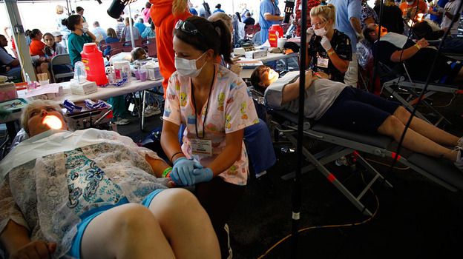
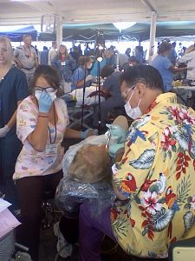
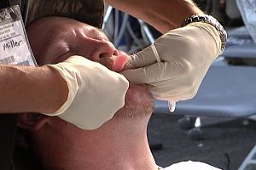
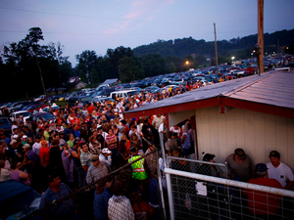
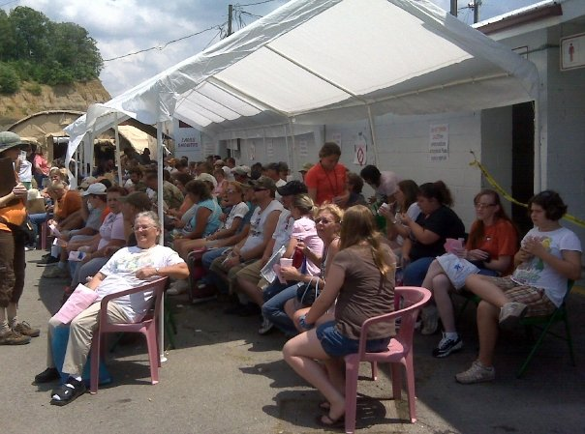
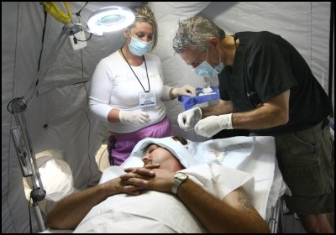
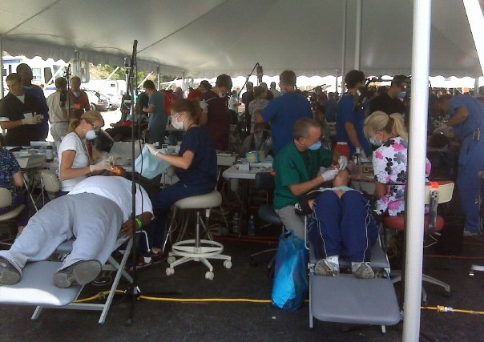
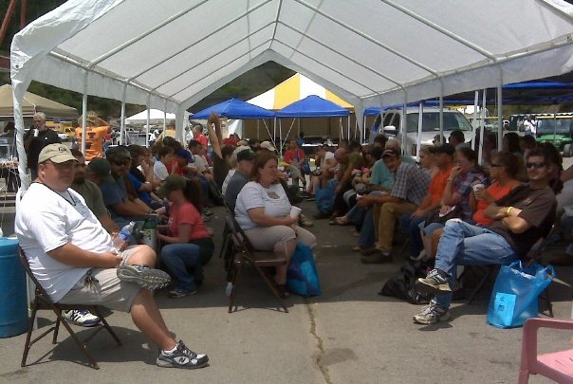
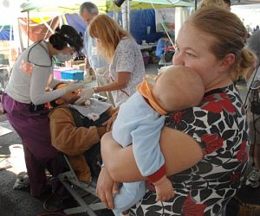

Slide 8
How was the Plan created?
Over 50 partners around Virginia
  Led by OMHHE, VRHA & VRHRC
Workgroups examined issues
48 recommendations developed
Launched va-shrp.org
Extensive progress since 2008
New plan coming in 2013

Slide 9

Rural Health Data Portal
Big Progress!

Slide 10
Where do you go for data?
Virginia Health Information
Virginia Department of Health, Health Statistics
Weldon Cooper Center for Public Service
Virginia Employment Commission’s Virginia Workforce Connection Labor Market Information
Virginia Department of Education, Virginia Education Statistics
State Council of Higher Education for Virginia
Virginia Rural Health Association
Virginia Rural Health Resource Center
Voices for Virginia’s Children
National Center of the Analysis of Healthcare Data
State & County QuickFacts
Small Area Income & Poverty Estimates
Small Area Health Insurance Estimates
Centers for Medicare & Medicaid Services
Nursing Home Compare
Health Resources and Services Administration
Hospital Compare
CLASP DataFinder
Centers for Disease Control & Prevention, Data & Statistics
World Health Organization, Data & Statistics
Old Way!

Slide 11
Now: Rural Health Data Portal
Pulls information into a single, easy to use website
Two main functions:
  Create Virginia health data charts and graphs
  Map data to create pictorial views
www.vrhrc.org

Slide 12
Data is available for...
Poverty:
  Federal Poverty Level
  below 100% FPL
  between 100%-200%
  No Vehicle
  NEMT region
  Income
  Single Parents
  Free/Reduced School Lunch
Workforce:
  HPSA-Primary
  HPSA-Mental
  HPSA-Dental
  Practitioners
  Practioner Ratio

Slide 13
Data is available for...
Population:
  Census Population
  Population Estimates
  Population by Race
  Population by Age
  Population-Elderly
  Population-Gender
Access:
  Medically Underserved Areas
  Prenatal Care
  Low Birth Weight
  Infant Mortality

Slide 14
Data is available for...
Facilities:
  Bed Rate
  Telemedicine sites
Insurance:
  Children without
  Disabled on Medicare
  Disabled on Medicare
  Uninsured

Slide 15
Data is available for...
Quality:
  Inpatient Quality
  Pediatric Quality
  Patient Safety
  Prevention Quality
  Hospital Quality
  Nursing Home Quality
Social Determinants of Health:
  Education
  Graduation Rate
  Unemployment
  Violent Crime Rate

Slide 16
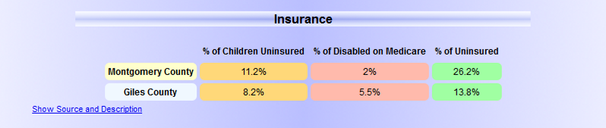
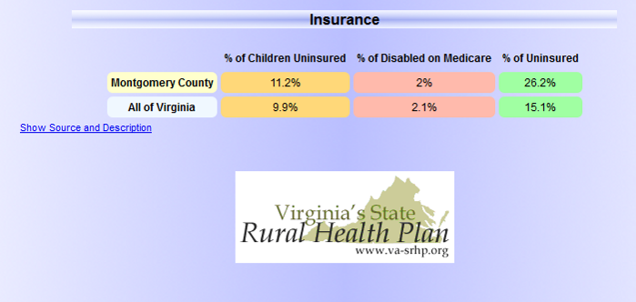
Show me the data!

Slide 17
Compare between…
Counties/Cities
Planning Districts
Health Districts
Health Planning Region
Levels of Rural Status

Slide 18
Map it!
Data is linked to a GIS mapping function which maps data and can add boundaries for:
  US Congressional Districts
  Virginia Senate District
  Virginia Delegate Districts
  Planning Districts
  Local Health Districts
  Economic Development Regions
  Core Based Statistical Areas
  City/Country Boundaries
  Census Tracts

Slide 19
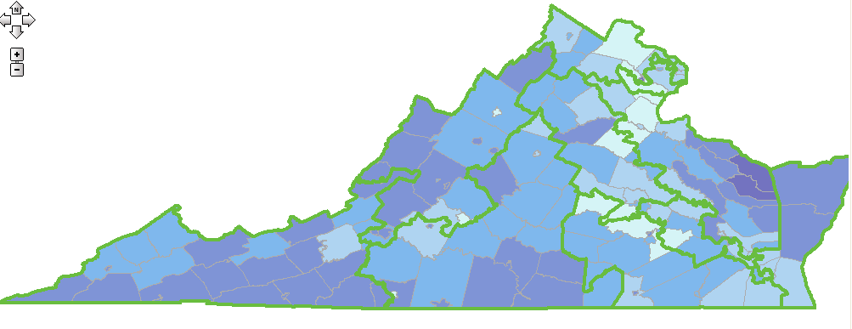
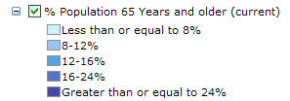
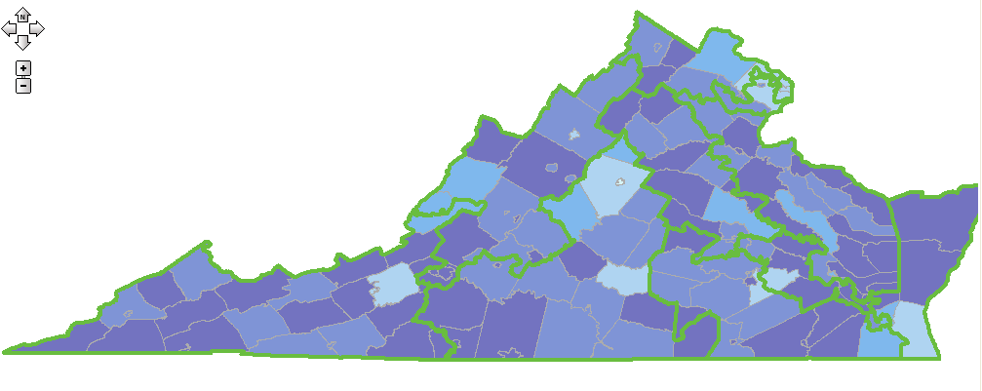
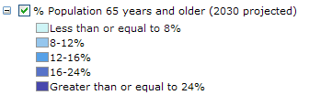
Population Age 65+ by US Congressional District
Current
2030
Projected

Slide 20
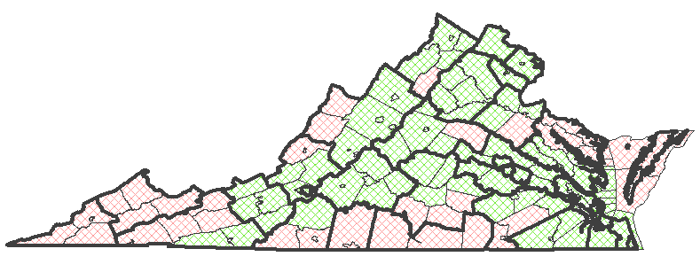
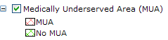
Medically Underserved Areas by Health District

Slide 21
Shall we try it out?

Slide 22
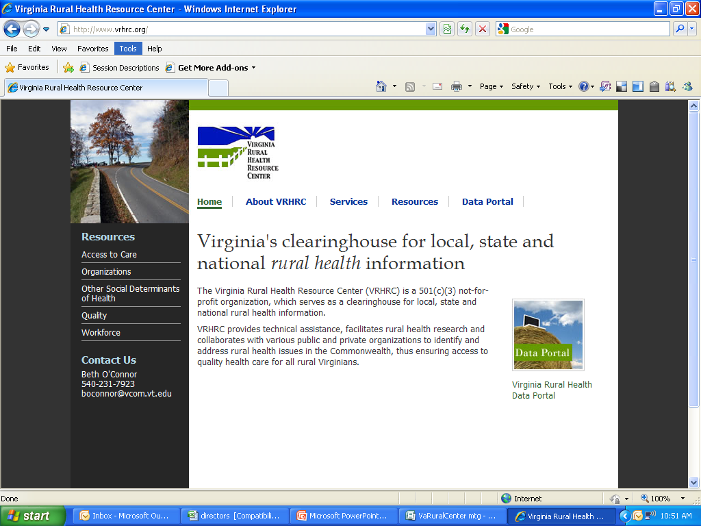
Enter Portal from VRHRC

Slide 23
Questions?
Beth O’Connor
Executive Director
Virginia Rural Health Association
540-231-7923
boconnor@vcom.vt.edu
www.vrha.org

