Slide 1
Fralin Translational Obesity Research Center

Slide 2
TORC-Vision
To be a Center of Excellence focused on improving health and quality of life in the Commonwealth and the Nation by reducing obesity and its consequences.

Slide 3
TORC-Objectives
To conduct obesity research that spans the translational spectrum from basic science to implementation science.
To train new investigators in translational obesity research methods.
To support clinical and community organizations in implementing and sustaining effective and broad reaching obesity-related programs, policies, and practices.

Slide 4
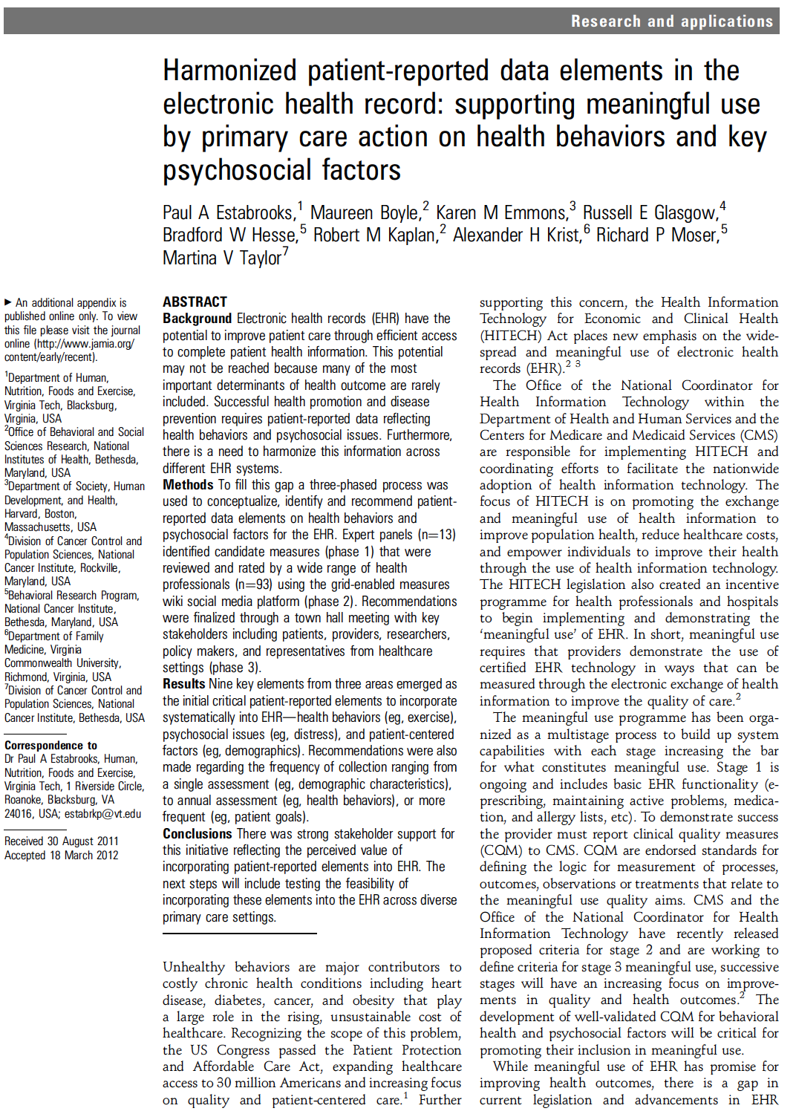
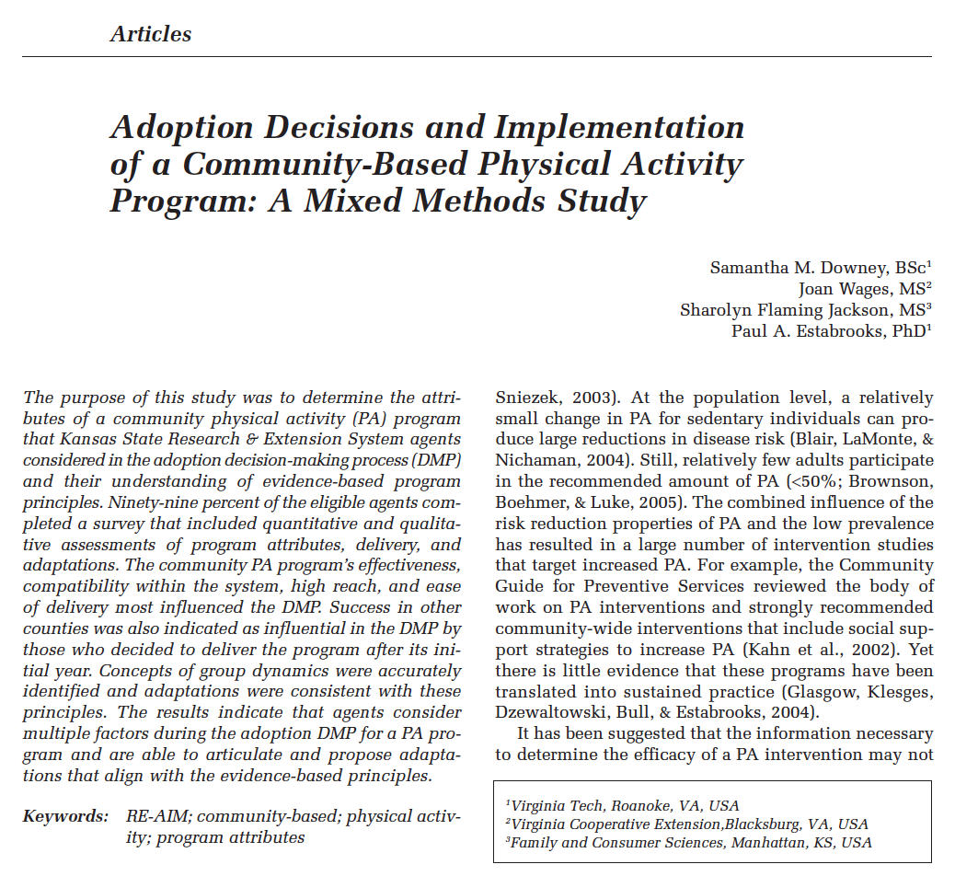
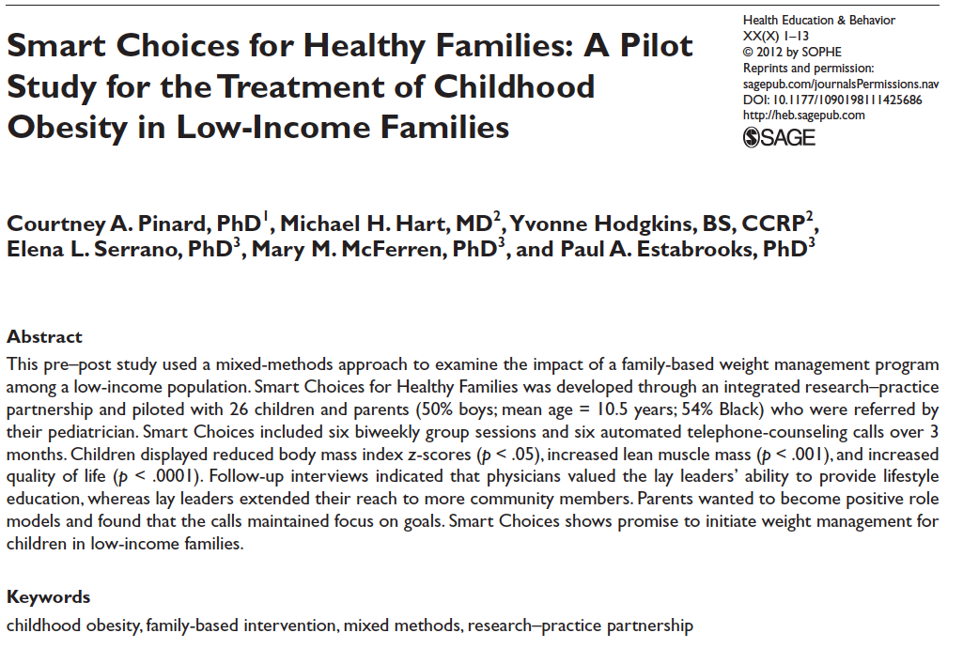
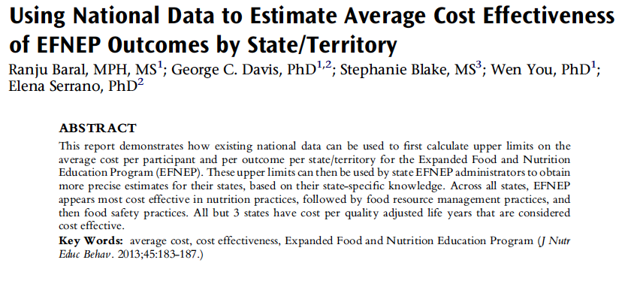
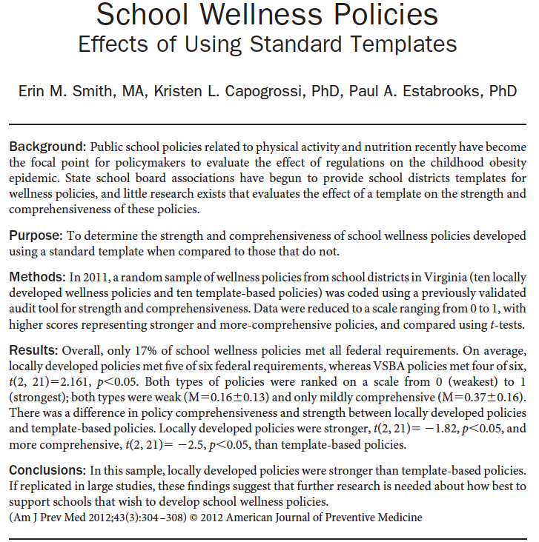
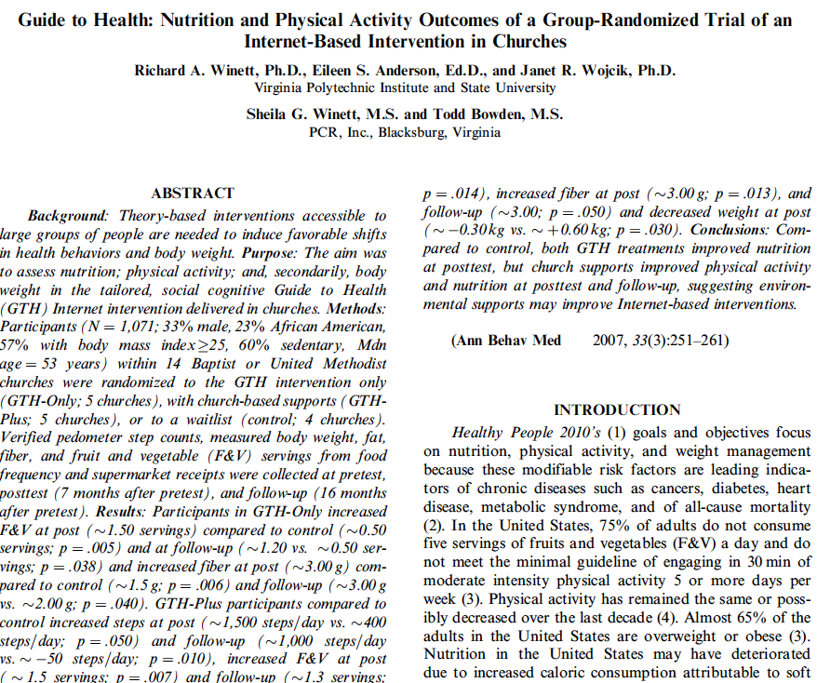
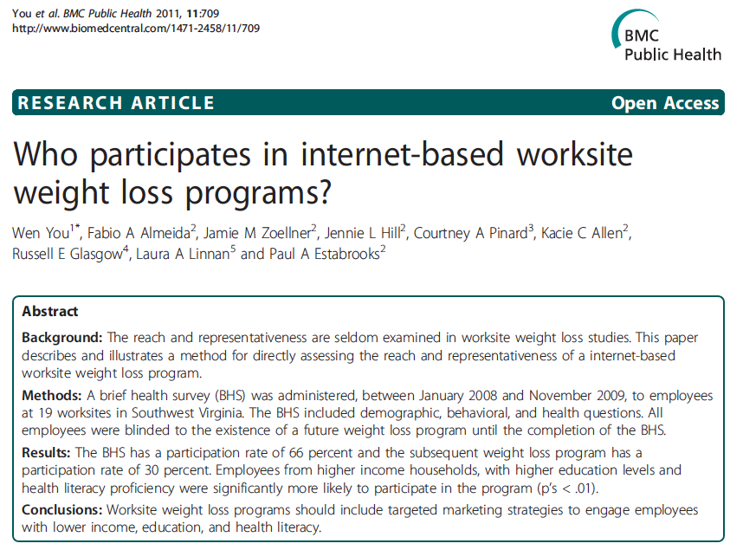
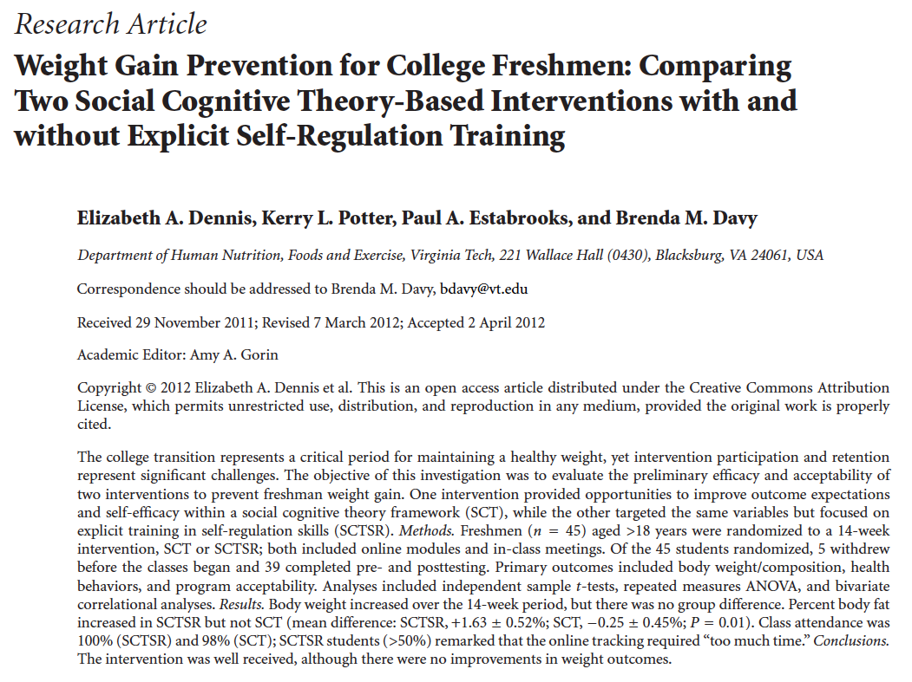

Slide 5
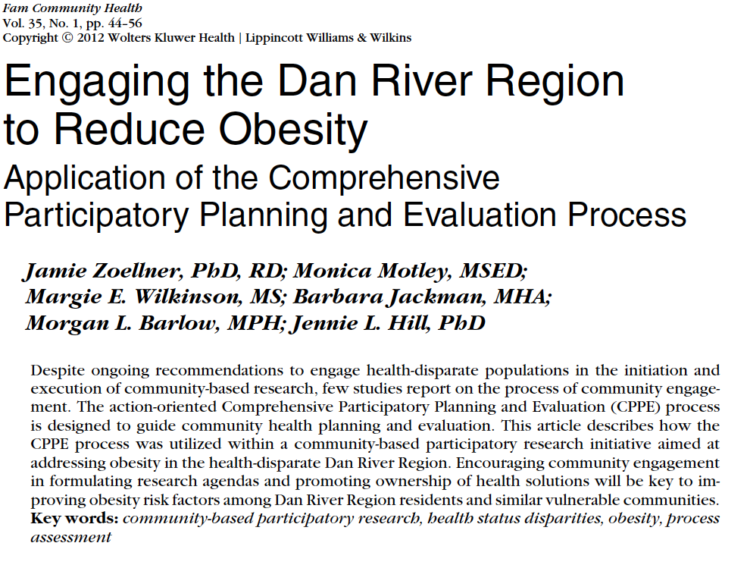
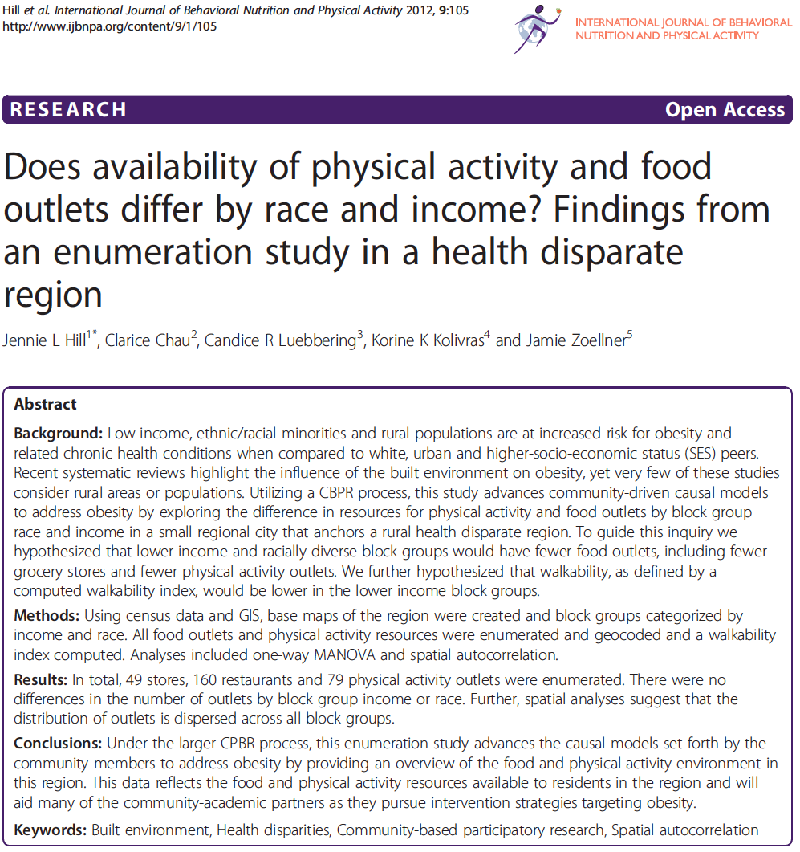

Slide 6
Resources
Developing Research-Practice Partnerships.
Center faculty have expertise in developing and sustaining research-practice partnerships in community and clinical settings.
Current federally funded projects address the development, testing, and integration of childhood obesity treatment strategies into a healthcare center and public health department as well as the implementation of weight management strategies within primary care offices.

Slide 7
Resources
Choosing the Appropriate Research Design and Evaluation.
Center faculty use the RE-AIM framework across community and clinical projects as a model to help plan and evaluate the public health impact of different strategies (see www.re-aim.org).
Implicit within our approach is the inclusion of cost data and a focus on pragmatic approaches to weight control, physical activity, and healthful eating.
We implement innovative and novel research design alternatives to randomized controlled trials.
Current federally funded projects include mixed methods designs, multiple wave case studies, preference designs, and interrupted time series designs

